Slide 1
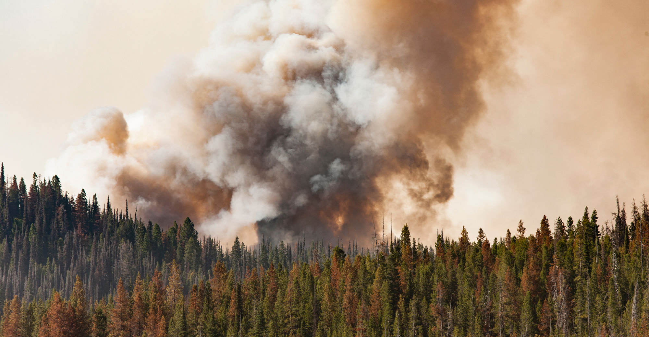
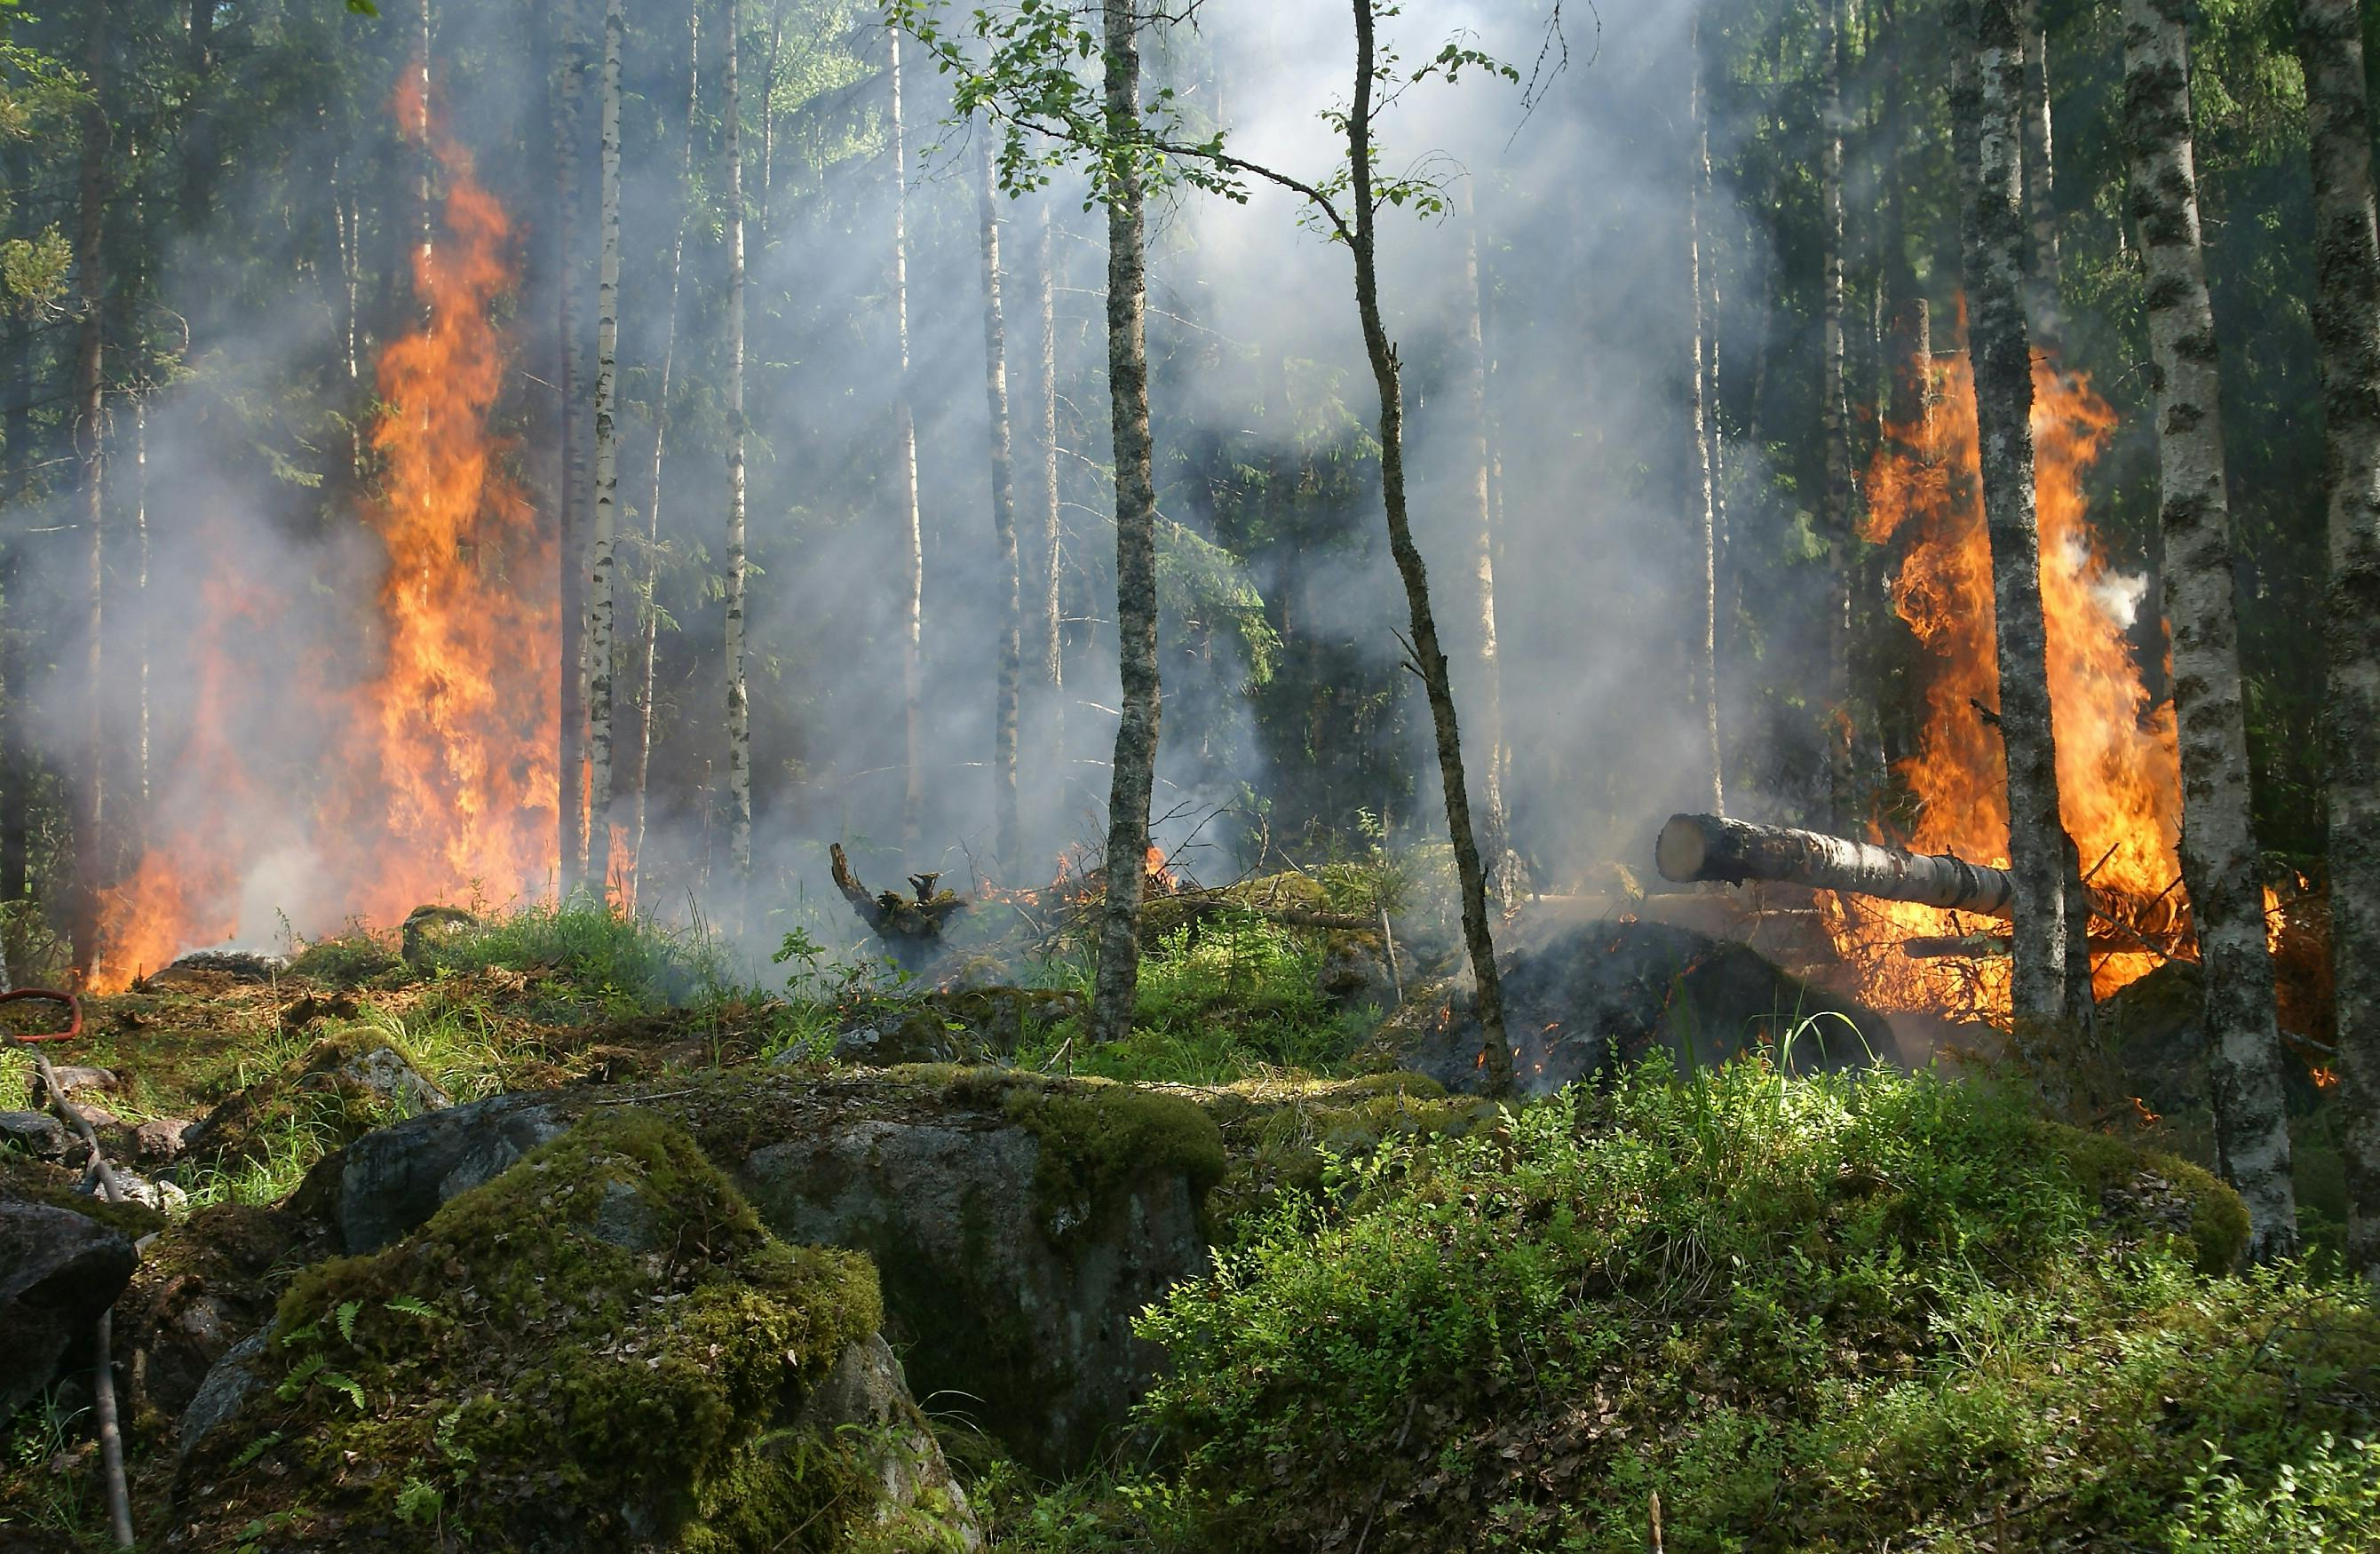
Alberta Wildfire Analytics
Data-Driven Insights for Wildfire Prevention and Response in Alberta

Slide 2
Group Members:
01 02 03 04 05
Akash Anand
Ayantika Chatterjee
Mohit Rathod
Ruchi Tiwari
Taran Kamboj

Slide 3
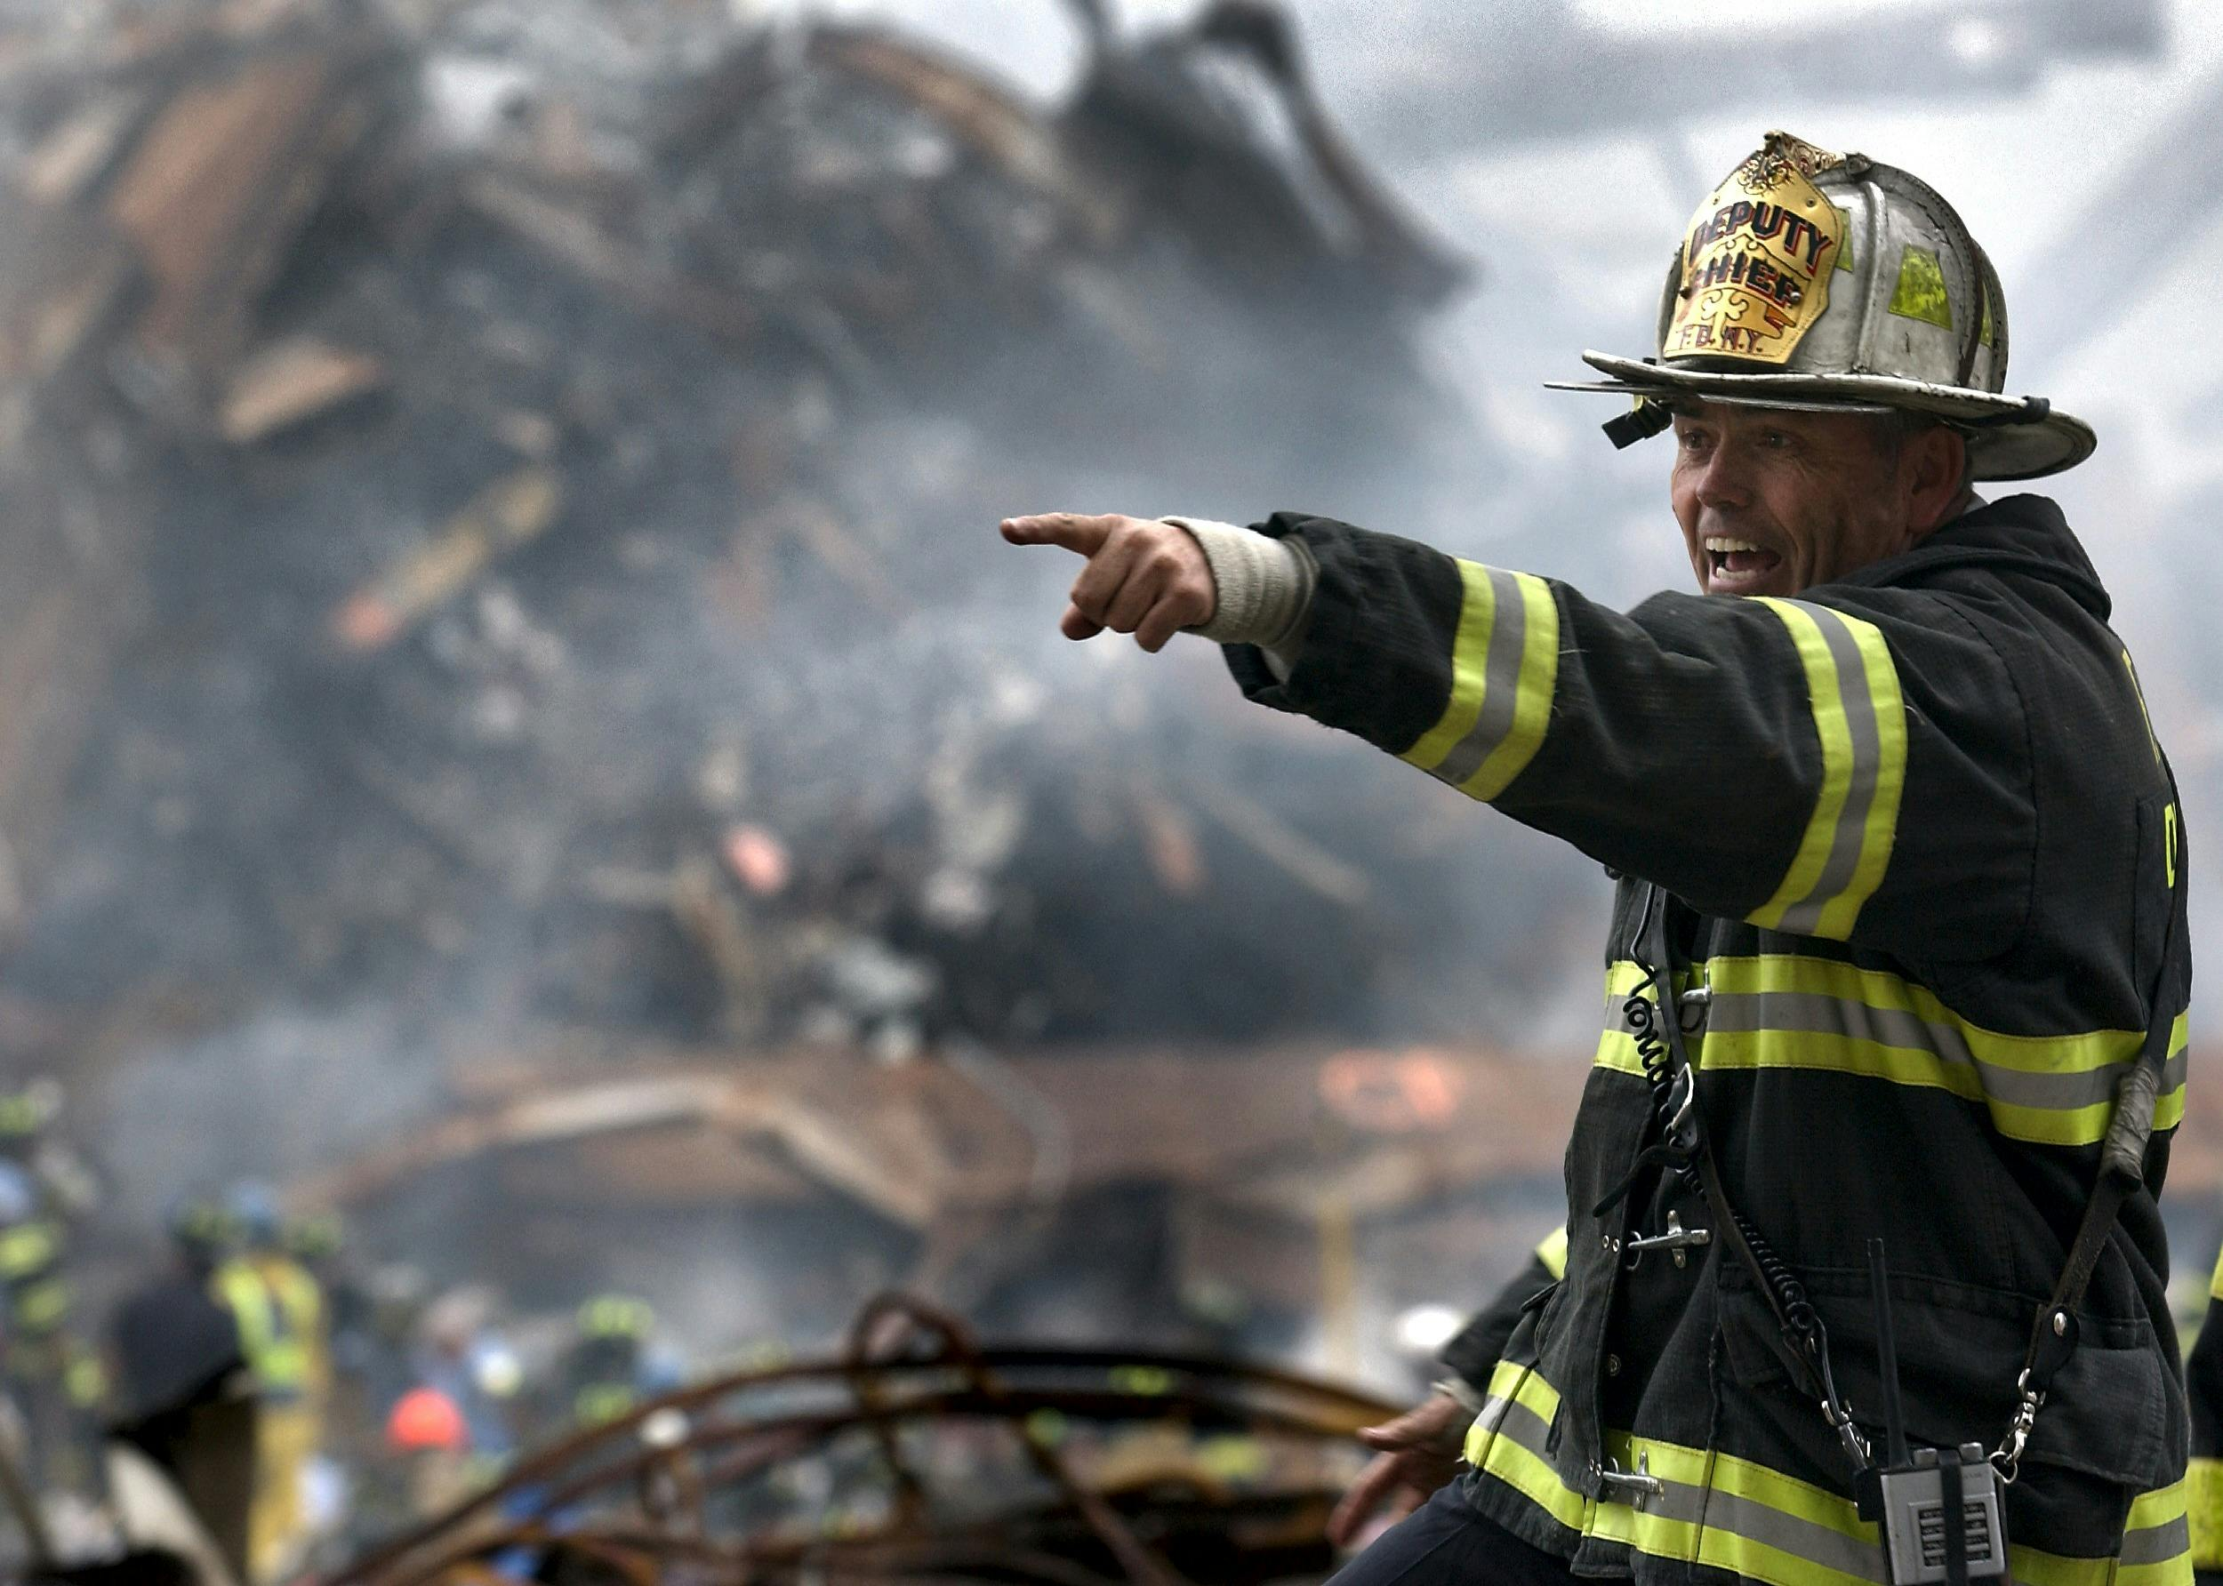
Introduction
01

Slide 4
Introduction
This Capstone project focuses on analyzing historical wildfire data in Alberta to support better decision-making and resource planning.
Using Python and Power BI, our team developed an interactive dashboard that visualizes wildfire trends, weather conditions, ignition causes, and regional risks from 2020 to 2023.
The goal is to empower Alberta Wildfire teams with a centralized, data-driven tool that enhances situational awareness, supports operational planning, and drives more effective wildfire response strategies.

Slide 5
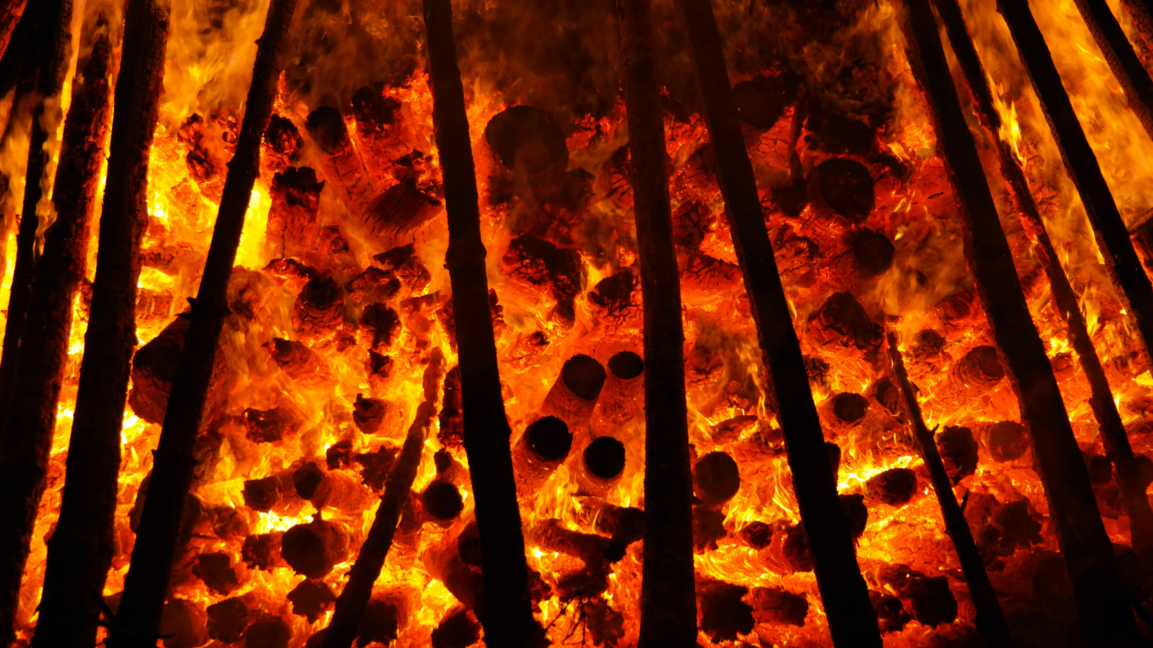
Business Problem and Requirements
02

Slide 6
Business Problem
Wildfires in Alberta are increasing in size, intensity, and frequency. Despite rich datasets, Alberta Wildfire lacked an integrated analytical tool to interpret trends and drive strategic planning.
Key Challenges:
Disconnected datasets
No centralized dashboard
Manual, reactive decision-making

Slide 7
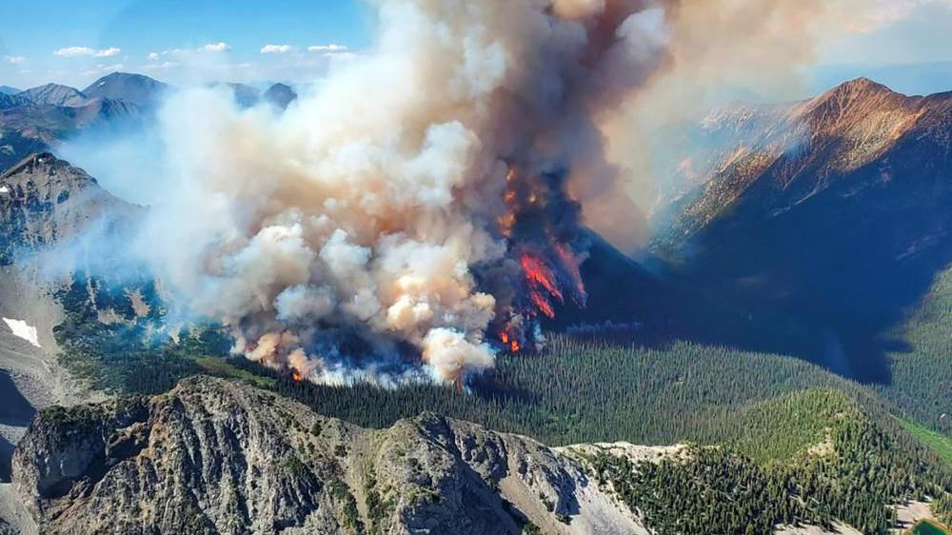
Key Analytical Questions
03

Slide 8
Key Analytical Questions
Trend Analysis:
How have wildfire occurrences and sizes in Alberta changed annually (2020–2023)?
Cause Analysis:
What are the leading causes of wildfires across Alberta’s regions and seasons?
Weather Impact:
How do Alberta’s weather conditions (temperature, humidity, wind) influence wildfire size and spread?
High-Risk Zones:
Which Alberta regions are most at risk based on historical and weather data?
Response Times:
How do detection agents and containment efforts vary by region?

Slide 9
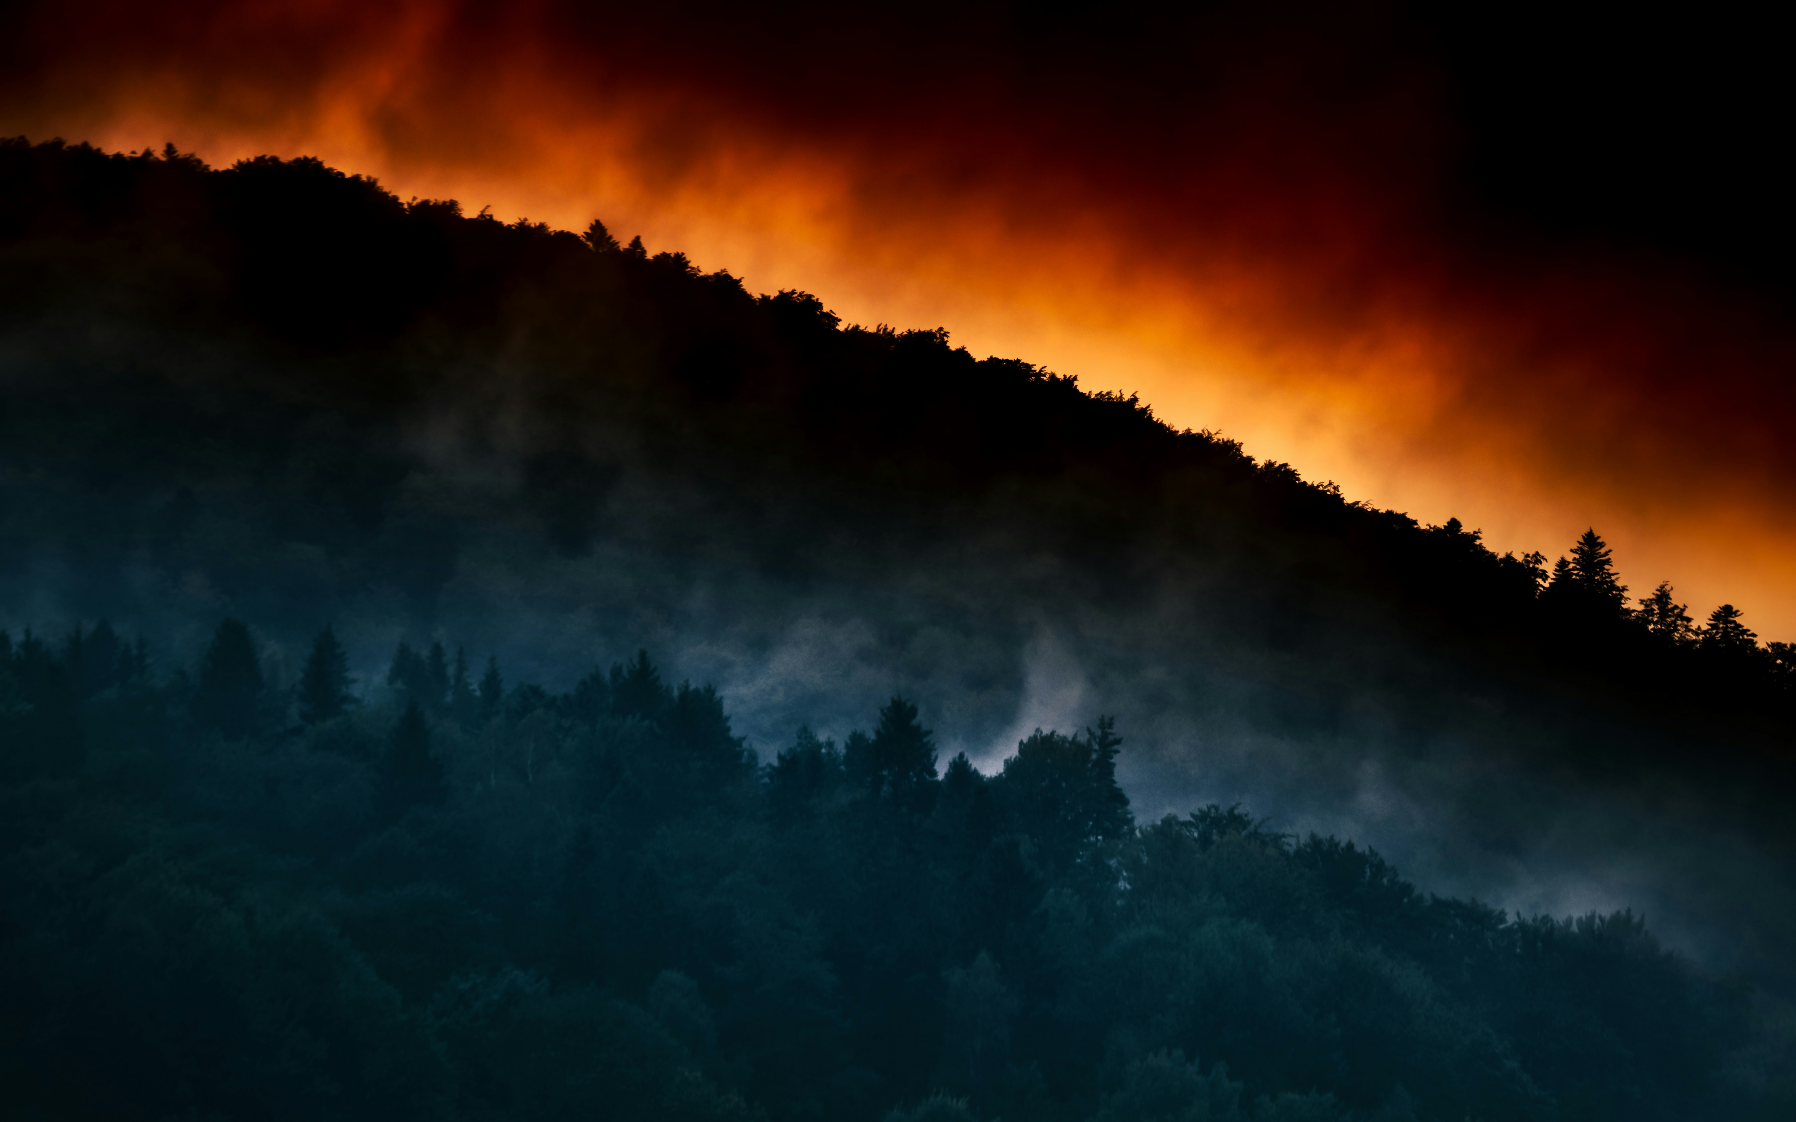
Project Scope Statement
05

Slide 10
Project Scope Statement
Wildfires in Alberta are increasing in size, intensity, and frequency. Despite rich datasets, Alberta Wildfire lacked an integrated analytical tool to interpret trends and drive strategic planning.
Key Challenges:
Disconnected datasets
No centralized dashboard
Manual, reactive decision-making
Project Goal: Build a centralized dashboard to enhance wildfire preparedness, response, and resource allocation.

Slide 11
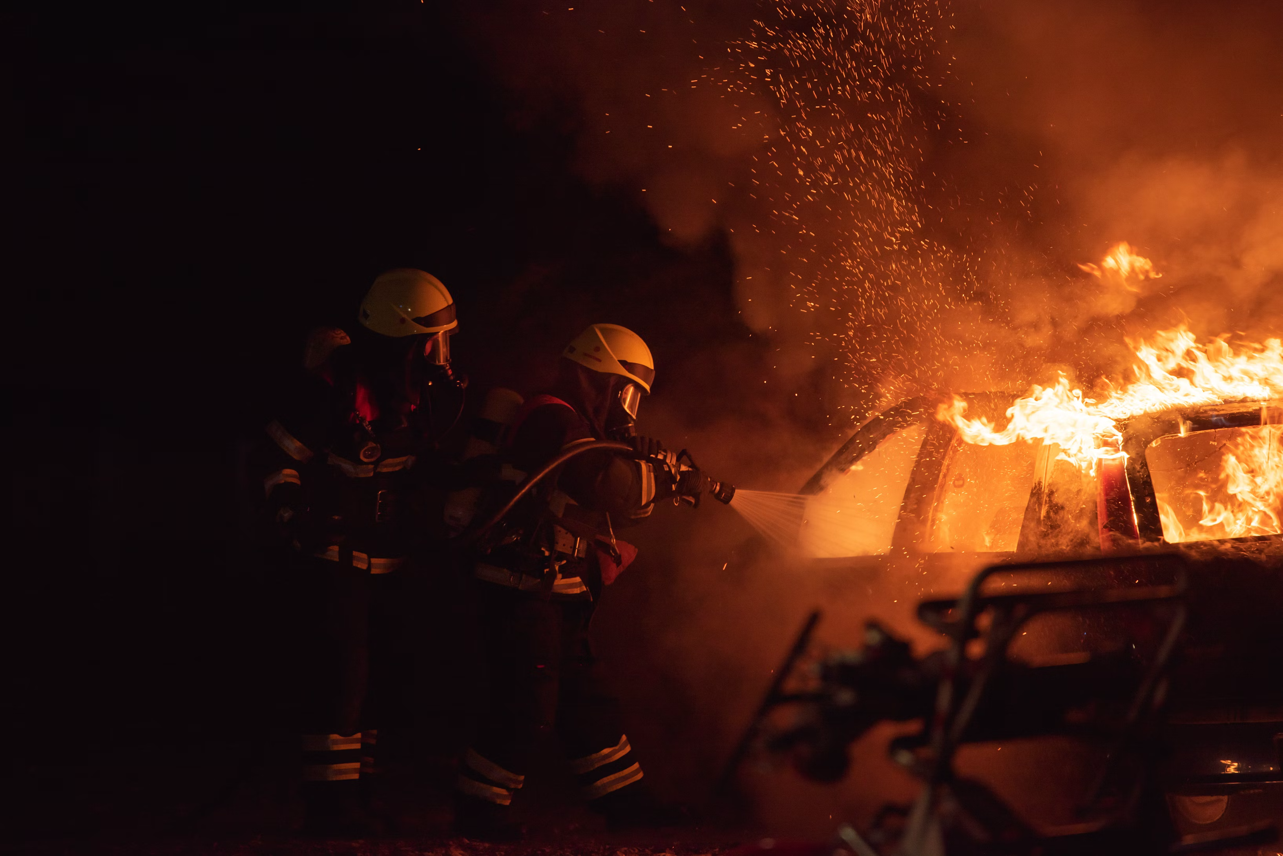
Data Sources & Flow
06

Slide 12
Data Source
Government of Alberta Open Data Portal
Wildfire events from 2006–2024 (used 2020–2023 for analysis)
Tools & Flow:
Python: Data cleaning, imputation, transformation
OneDrive: Cloud-based storage and integration
Power BI Desktop: Star schema modeling, visuals
Power BI Service: Dashboard deployment and refresh

Slide 13
Data Preparation
07

Slide 14
Data Preparation
Using Python:
Removed irrelevant/missing columns
Imputed missing values (mean/mode/KNN)
Standardized names, binned weather metrics
Using Power BI (Power Query):
Promoted headers, cast types, created surrogate keys
Linked to 16 dimension tables
Created new features like Risk Score & Season
Result: Clean, optimized dataset feeding into a dynamic and scalable star schema.

Slide 15
Solution Design
08

Slide 16
Data Preparation
Methodology: CRISP-DM Architecture:
Central Fact Table: wildfire incidents
16 Dimension Tables: cause, location, season, weather, agents, etc.
Technology Stack:
Python (preprocessing)
OneDrive (cloud storage)
Power BI Desktop & Service (model + reporting)
Security: Role-based access for authorized wildfire analysts

Slide 17
Dashboard
09

Slide 18
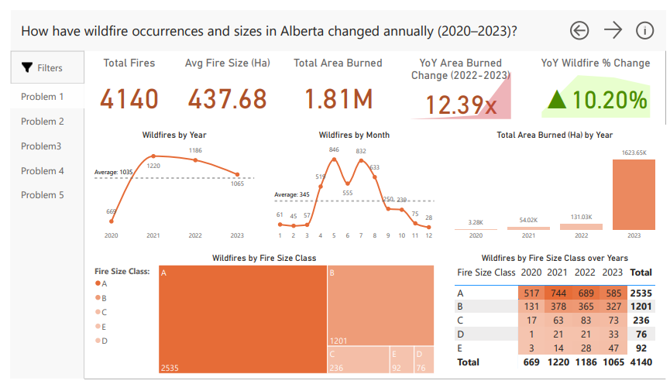
1. How have wildfire occurrences and sizes in Alberta changed annually (2020-2023)?
Wildfire Trends (2020–2023)
4,140 total fires, peaking in 2021
Average size: 437.68 ha
2023 saw 12.4× more area burned than 2022
Fire count dropped 10.2%, but severity rose
Peak fire months: May to July
Class A fires made up most incidents (2,535)

Slide 19
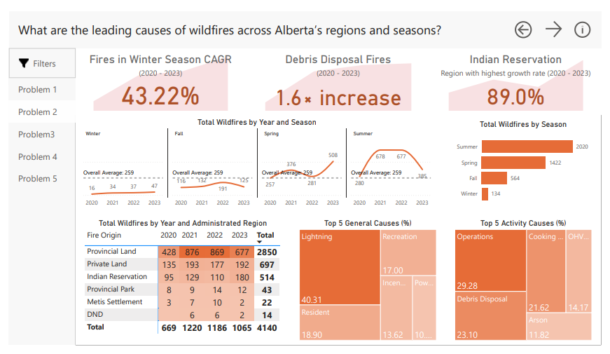
2. What are the leading causes of wildfires across Alberta’s regions and season?
Leading Causes of Wildfires – Alberta
Lightning is the top general cause (40.3%)
Operations and Debris Disposal are top activity causes
Winter fires grew rapidly (43.22% CAGR)
Debris Disposal fires increased by 1.6x
Indian Reservation saw the highest regional growth (89%)
Most fires occur in Summer, followed by Spring

Slide 20
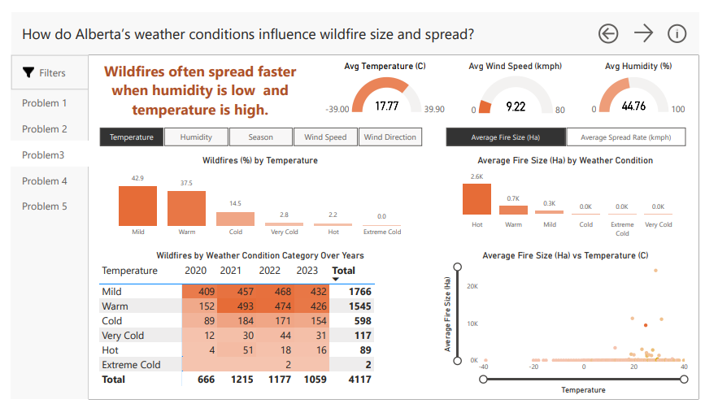
3. How do Alberta’s weather conditions influence wildfire size and spread?
Impact of Weather on Wildfire Size & Spread
Fires spread more under high temperatures and low humidity
Mild and Warm temperatures account for 80% of all fires
Low humidity (avg. 44.76%) correlates with greater fire spread
Wind speed averaged 9.22 km/h, with moderate winds contributing to spread

Slide 21
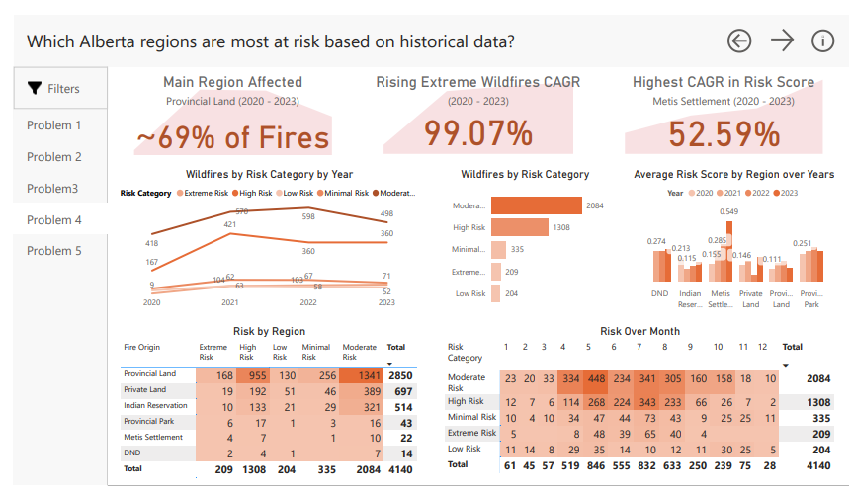
4. Which Alberta regions are most at risk based on historical data?
Most At-Risk Regions – Alberta
Provincial Land accounts for ~69% of wildfires
Extreme-risk fires grew at a 99.07% CAGR
Metis Settlement saw the highest rise in average risk score (52.59%)
Risk peaks May –July, aligning with fire season

Slide 22
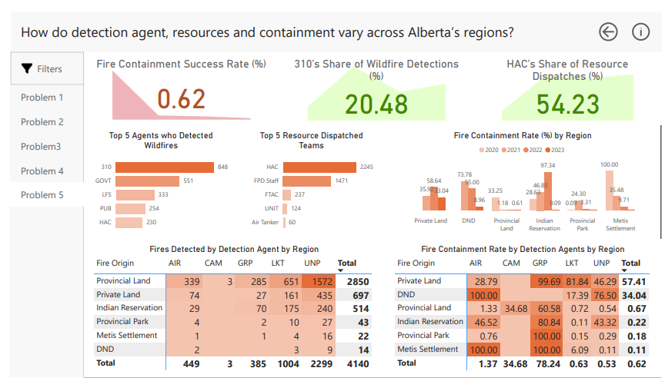
5. How do detection agent, resources and containment vary across Alberta’s regions?
Detection, Resources & Containment – Alberta
310 is the top detection agent, reporting 20.48% of wildfires
Overall containment rate across Alberta is 62%
Private Provincial Land, despite most fires, showed lower containment efficiency
Agent performance varies widely -CAM and GRP show high success

Slide 23
Optimization Opportunities
10

Slide 24
Optimization Opportunities
Automated Data Ingestion
Use gateway or API instead of manual CSV uploads
Predictive Modeling
Apply ML for forecasting fire severity or region-level risk
External Data Integration
NDVI, weather APIs, land use maps
Enhanced UX
Tutorials, tooltips, custom bookmarks
Performance Tuning
Use pre-aggregated tables & incremental refresh

Slide 25
Conclusion
11

Slide 26
Conclusion
We successfully built and deployed a Power BI dashboard that:
Python (preprocessing)
Centralizes and visualizes wildfire data
Answers five critical decision-support questions
Enables interactive exploration of trends, risks, and performance
Integrates seamlessly into Alberta’s IT ecosystem
Next Steps:
Expand to predictive analytics
Automate data pipelines
Explore real-time tracking integration

Slide 27
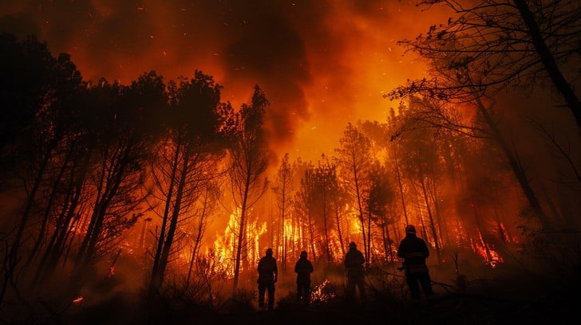
A picture is worth a thousand words…

Slide 28
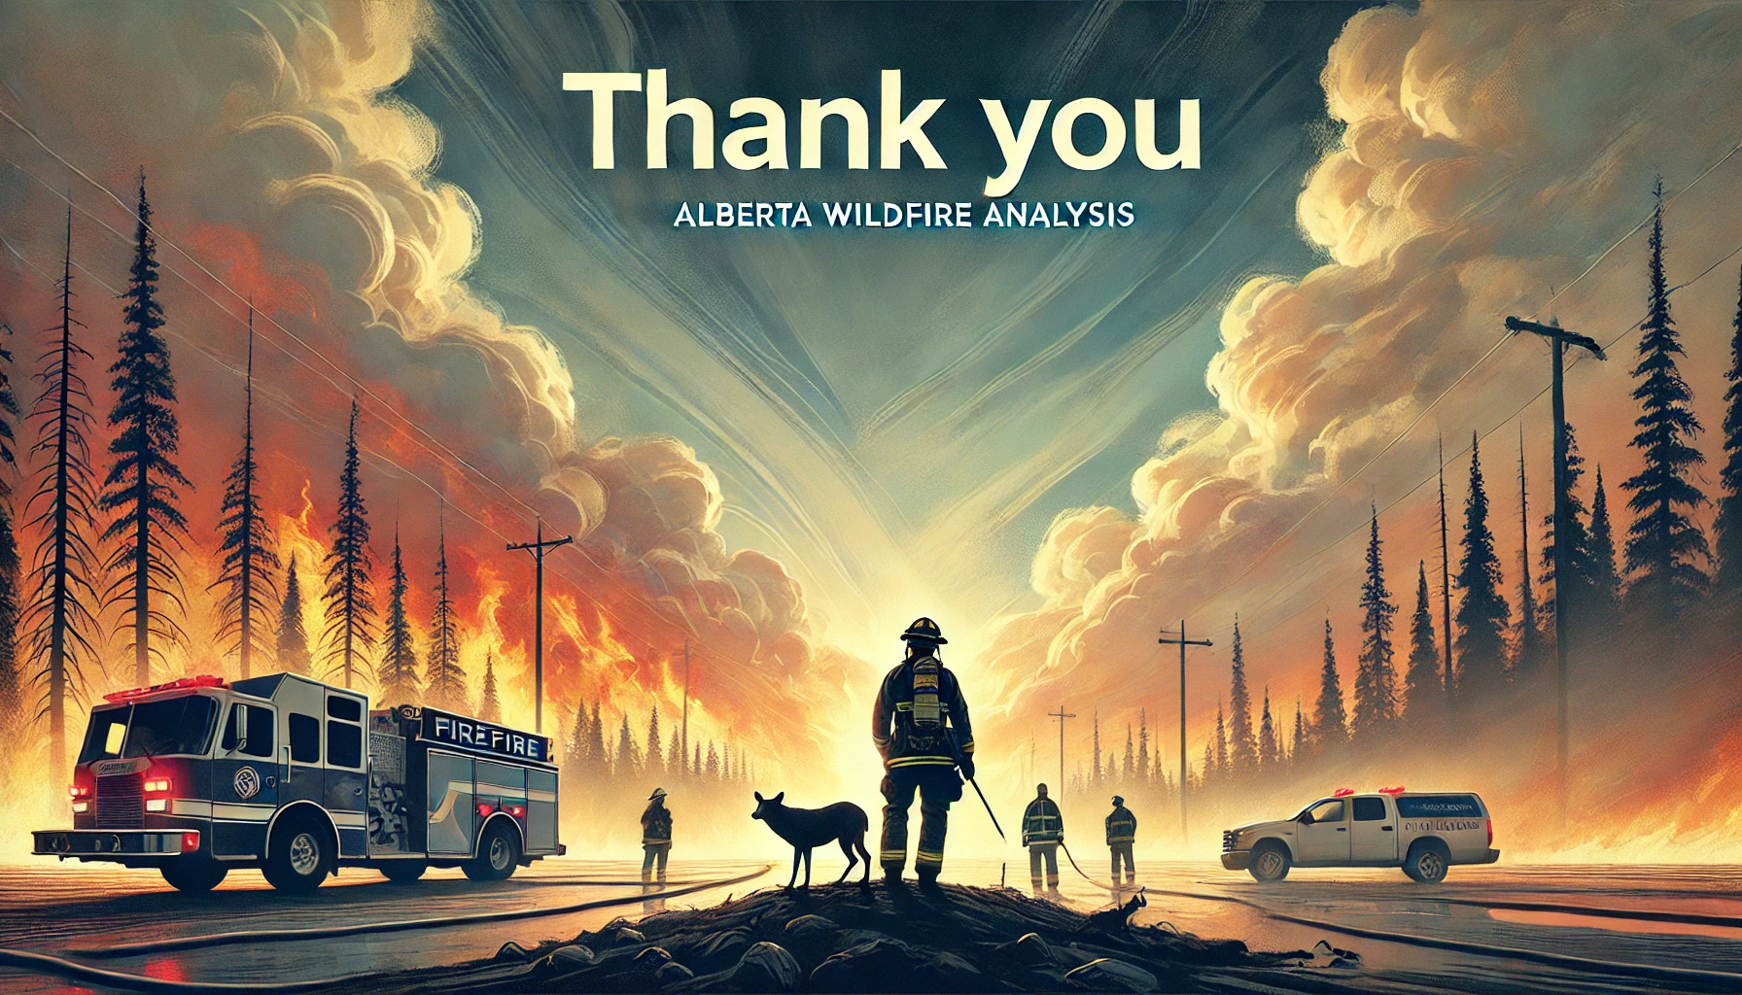
Thank You!
Big numbers catch your audience’s attention

